Slide 1
Stationary Processes & ARMA Modelling

Slide 2
Non-seasonal ARIMA models
When differencing is combined with autoregression and a moving average model, a non-seasonal ARIMA model is obtained.
ARIMA, short for AutoRegressive Integrated Moving Average, uses 'integration' to denote the reverse of differencing.“
ARIMA (p,d,q) model
p - order of the autoregressive part;
d - degree of first differencing involved;
q - order of the moving average part.
Notes:
https://fred.stlouisfed.org/series/PCECTPI

Slide 3
ACF and PACF
The ACF (Autocorrelation Function)
Shows the correlation between a series and its lagged versions. It tells us the total amount of autocorrelation at each lag.
Shows the total correlation between a time series and its lagged versions. It's like asking, "How much does today's value depend on the value from 1 day ago, 2 days ago, 3 days ago, and so on?" This correlation is both direct and indirect
The PACF (Partial Autocorrelation Function)
Shows the correlation between a series and its lagged versions, after removing the effects of all the intermediate lags. It tells us the direct correlation between an observation and its past values.
Shows the direct correlation between a time series and its lagged versions. It answers the question, "How much does today's value depend directly on the value from 3 days ago, after accounting for the influence of the values from 1 and 2 days ago?"
The Key: The patterns in these plots for a stationary series are like a fingerprint for the underlying AR and MA components.

Slide 4
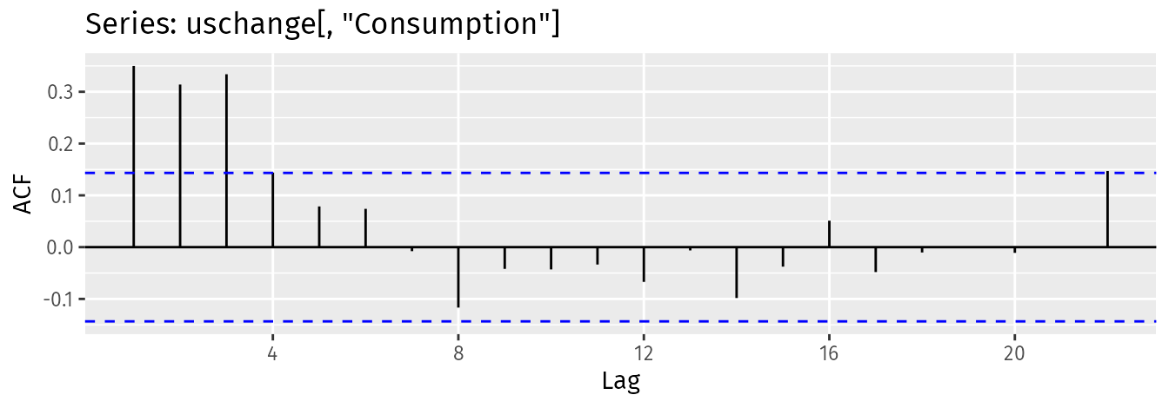
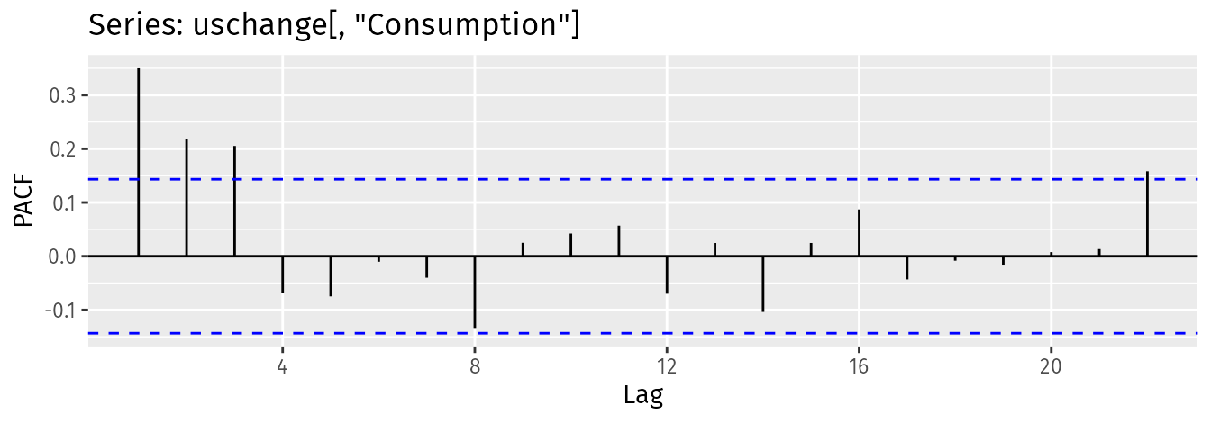
Order Selection (ACF and PACF plots)

Slide 5
Parameter Estimation
Objective
To learn how to estimate the coefficients of an ARMA(p,q) model from observed time series data.
Why is this important
Estimating these parameters is crucial for building a predictive model.
The values of these parameters provide insights into the underlying dynamics of the time series.
Key question
How do we find the "best" set of parameters that explain the data?
We can't get them perfectly, so we use statistical methods to find the most probable values.

Slide 6
Yule-Walker Estimation: For AR Models
Background
The Yule-Walker equations are a set of linear equations that relate the theoretical autocorrelations of a stationary AR(p) process to its coefficients.
The Idea
We can estimate the sample autocorrelations (ρk) from the observed data.
We then substitute these sample autocorrelations into the theoretical Yule-Walker equations.
This gives us a system of linear equations that can be solved to find the estimated AR coefficients( ϕ1,...,ϕp).

Slide 7
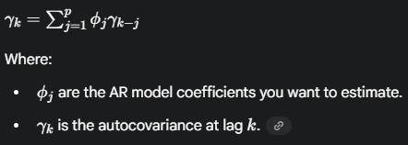
How It works?
The core idea is to replace the theoretical autocorrelations in the Yule-Walker equations with their sample estimates from the data. For a stationary AR(p) process, the equations are:

Slide 8
Advantages and Disadvantages
Advantages
Computational Efficiency: Yule-Walker estimation is computationally fast because it involves solving a linear system of equations, unlike other methods that require iterative optimization.
Simplicity: The method provides a direct and simple way to obtain parameter estimates, making it easy to implement.
Guaranteed Stationarity: The parameter estimates obtained using this method are guaranteed to result in a stationary AR model, which is a desirable property for forecasting.
Disadvantages
Assumes Stationarity: The method strictly assumes that the time series is stationary. If the data has a trend or seasonality, it must be differenced first.
Sensitivity to Short Samples: Estimates from Yule-Walker can be biased in small samples and may perform poorly if the model's poles are close to the unit circle, which can lead to ill-conditioned autocovariance matrices.
Less Efficient than MLE: While computationally faster, the estimates from Yule-Walker estimation are not as asymptotically efficient as those from Maximum Likelihood Estimation (MLE), especially for small sample sizes.

Slide 9
Maximum Likelihood Estimation (MLE)
Concept
MLE is a general statistical method for estimating the parameters of a model. The goal is to find the parameter values that make the observed data "most probable."
How it works for ARMA
Assume the errors (residuals) are normally distributed (a common assumption).
Write down the likelihood function, which expresses the probability of the data as a function of the unknown parameters (ϕ,θ,σ2).
Find the parameter values that maximize this likelihood function. This is typically done using numerical optimization algorithms.
Advantages:
Provides more efficient and statistically robust parameter estimates than the Yule-Walker method.
Works for all AR, MA, and ARMA models.
Allows for the calculation of standard errors for the parameter estimates, which helps in hypothesis testing (e.g., checking if a coefficient is significantly different from zero).
Note: We will not derive the likelihood function in this session, as it's complex. The focus is on the conceptual understanding and application in Python.

Slide 10
Why Use MLE for ARIMA?
Asymptotic Efficiency: MLE estimates are asymptotically efficient, meaning they have the lowest possible variance among all consistent estimators as the sample size grows. This results in more precise parameter estimates.
Reduced Bias: MLE generally produces less biased estimates, especially in smaller sample sizes, compared to alternative methods like Yule-Walker.
Unified Framework: MLE provides a single, coherent framework for estimating parameters for the full ARIMA family, including AR, MA, and ARMA models.

Slide 11
Imputing Missing Values in Time Series
The Problem
Gaps (NaNs) in time series data disrupt continuous models. These can be caused by sensor failures, data entry errors, or outages.
Why not simple methods?
Replacing NaNs with a simple mean or zero can severely distort the data's underlying trend, seasonality, and autocorrelation.
The Goal
Impute values while preserving the original data's temporal structure.

Slide 12
Common Imputation Methods
Forward-Fill (.ffill())
Carries the last observed value forward. Best for sensor data where a value remains constant until a new one is recorded.
Backward-Fill (.bfill())
Fills from the next available value. Useful for data that can be back-filled from a known future point.
Linear Interpolation (.interpolate(method='linear’))
Fills the gap by drawing a straight line between two known points. Effective for series with a clear, linear trend.

Slide 13
Advanced Methods (For Complex Data)
Spline/Polynomial Interpolation
Uses a polynomial function to create a smoother, more realistic curve. Good for capturing non-linear patterns.
Example: s.interpolate(method='spline', order=2)
Seasonal Interpolation
Fills gaps based on the value from the same period in previous seasons.
Model-Based Imputation
Uses an ARIMA or other time series model to predict the missing values.
This is the most accurate method as it uses the data's own dynamics for imputation.

Slide 14
Best Practices
Visualize First
Always plot the data to understand the nature and extent of the missing values.
Choose Wisely
Select an imputation method that matches the data's characteristics.
Document
Note which method you used, as it's a critical step in your data preprocessing.
Avoid Extrapolation
Do not try to fill NaNs at the very beginning or end of your series using interpolation methods.

